Slide 1
Influence of nose in facial expression detection
SUBMITTED BY:
ABHINANDAN ROY
Roll: CSUG/019/14
Reg: A03-1112-0033-14
SUJASH NASKAR
Roll:CSUG/033/14
Reg: A03-1112-0034-14
JOYJYOTI DAS
Roll:CSUG/044/14
Reg:A03-1112-0035-14

Slide 2
Nose
Nose is one of the important landmarks in the face that is used to detect particular face. Every human faces have a nose but the structure of the nose might vary from person to person. The nose can also be characterized by two dark regions, corresponding to the nostrils, and a light region, corresponding to the reflex of the light on the nose tip.
The various features of the nose which are useful for detection of the nose as well as facial recognition and detection are:
Both the corners of the nostrils.(Width of the nose)
The corners of the nostrils are measured to determine the width of the nose. This implies that the rightmost corner of the right nostril and the leftmost corner of the left nostril is to be measured.
Length of the nose
The length of the nose might vary from person to person and hence adds up to an essential feature that could be used to differentiate between human faces
The nose tip
The height of the nose is also a property that generally varies from person to person and hence even this feature could be used to create an ideal system to recognize faces

Slide 3
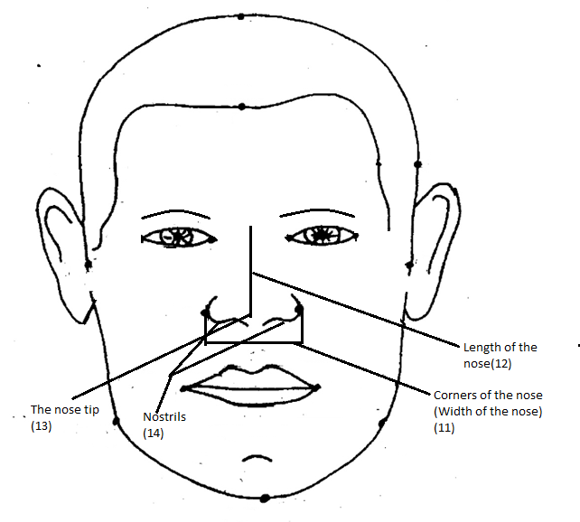
Human Face with parts of nose labeled:-
1)Length of the nose
2)The nose tip
3)Nostrils
4)Corners of the nose(Width of the nose)

Slide 4
Viola-jones algorithm
The characteristics of Viola–Jones algorithm which make it a good detection algorithm are:
Robust – very high detection rate (true-positive rate) & very low false-positive rate always.
Real time – For practical applications at least 2 frames per second must be processed.
Face detection only (not recognition) - The goal is to distinguish faces from non-faces (detection is the first step in the recognition process).
The algorithm has three stages:
Haar Feature Selection:Haar like features are used to detect variation in the black and light portion of the image.
Creating an Integral Image: They are also known as summed area tables. Integral image is used to felicitate quick feature detection. The meaning of integral image is the outline of the pixel values in the original images.
Adaboost Training: AdaBoost algorithm helps to select small features from the face that facilitates fast and easy computation .Unlike other methods, AdaBoost algorithm gives desired region of the object discarding unnecessary background. AdaBoost learning process is fast and gives more number of desired data.

Slide 5
Nose detection using Viola-Jones Algorithm code
I = imread('girl.jpg');
%I=rgb2gray(RGB);
NoseDetect = vision.CascadeObjectDetector('Nose','MergeThreshold',16);
BB=step(NoseDetect,I);
figure,
imshow(I); hold on
for i = 1:size(BB,1)
rectangle('Position',BB(i,:),'LineWidth',2,'LineStyle','-','EdgeColor','b');
end
title('Nose Detection');
nose=imcrop(I,BB);
figure,imshow(nose);

Slide 6
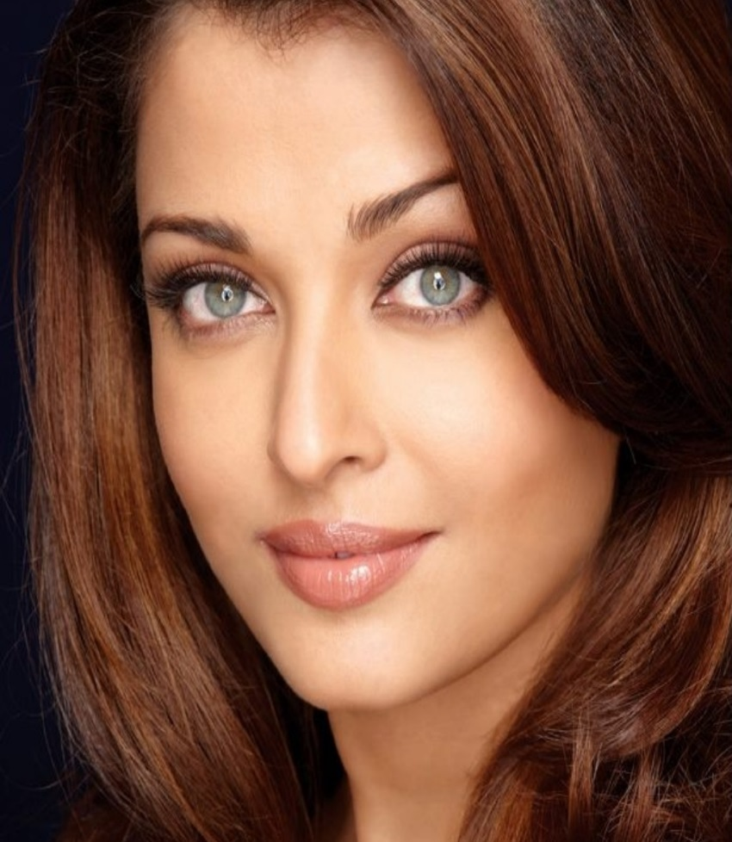
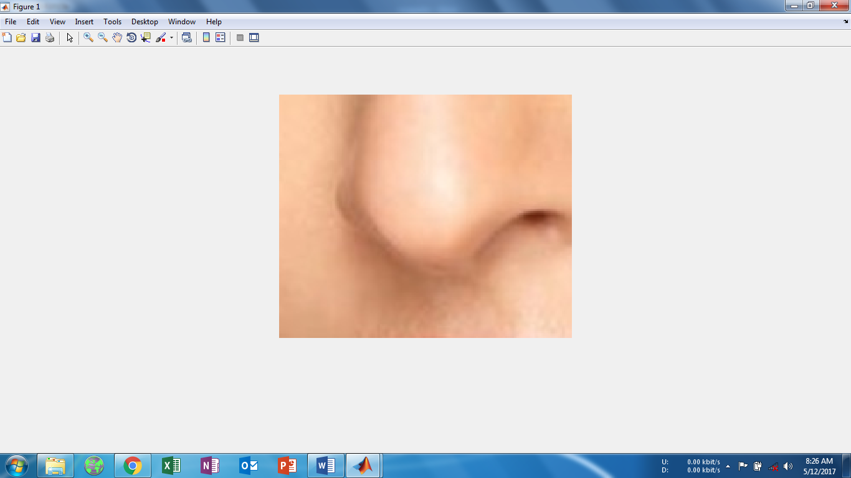
Original image Cropped out nose

Slide 7

Finding the nose tip
After cropping the nose we need to find the nose tip.For that we need to find the centroid of the cropped image.This is achieved by converting the RGB image to grayscale and using the method regionprops() based on a specified label.
Ibw = im2bw(nose);
Ibw = imfill(Ibw,'holes');
Ilabel = bwlabel(Ibw);
stat = regionprops(Ilabel,'centroid');
imshow(nose);hold on;
for x = 1: numel(stat)
plot(stat(x).Centroid(1),stat(x).Centroid(2),'ro');
end

Slide 8
Detection of ends of the nose
To detect the ends of the nose we have used the BB box of the Viola‑jones algorithm.the BB box consists of the (X,Y) coordinates of the topmost left corner and the length and the width.The box consists of the cropped nose.so by some mathematical calculations we can easily determine the end points of the nose.
tx=BB(1);
ty=BB(2);
a=BB(3);
b=BB(4);
figure(5),imshow(I),hold on;
plot(tx+2,ty+b/2,'ro');
plot(tx+a-2,ty+b/2,'ro');
plot(tx+a/2,ty+2,'ro');
plot(tx+a/2,ty+b-2,'ro');
hold off;

Slide 9
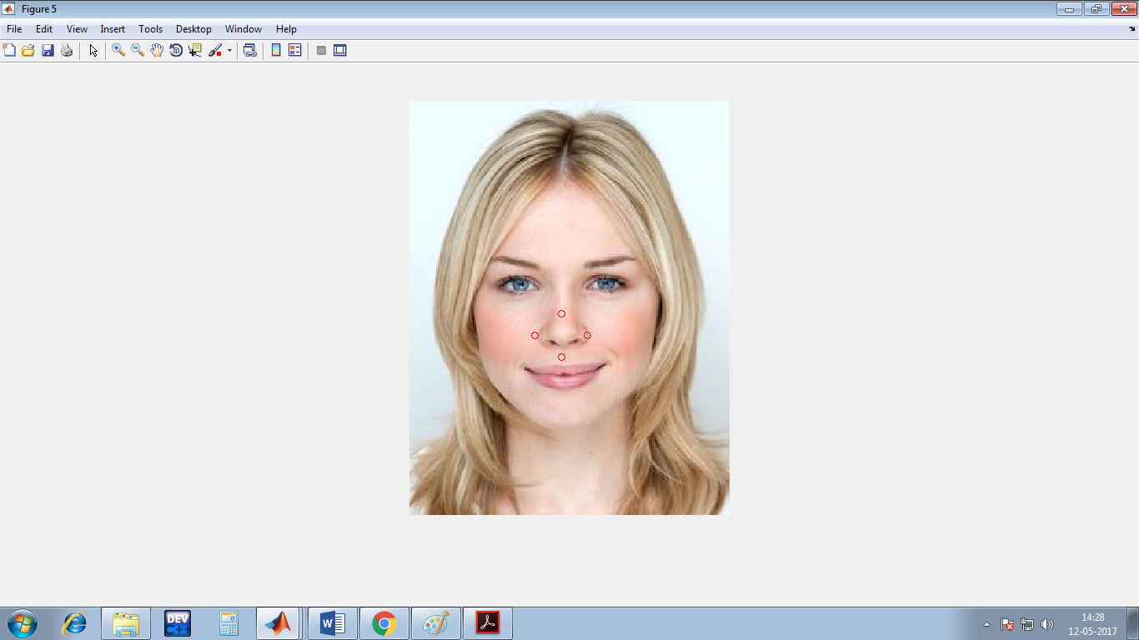
Ends of the nose are represented by red circles

Slide 10
Segmentation
The first step taken is to divide the image into three images based on the intensities of each red, green and blue component within the image. This is Color Based Image Segmentation. The blue plane is the best choice to use for Image Thresholding because it provides the most contrast between the desired object (foreground) and the background. Image Thresholding takes an intensity image and converts it into a binary image based on the level desired. A value between 0 and 1 determines which pixels (based on their value) will be set to a 1 (white) or 0 (black)).

Slide 11
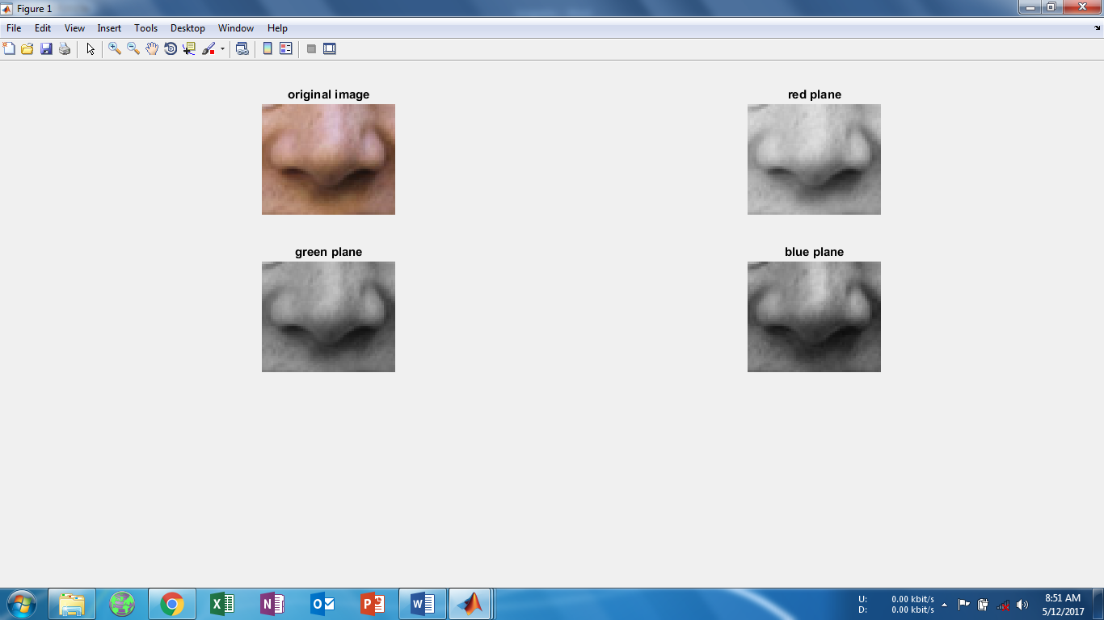
Segmentation
Division of the image into three images based on the intensities of each red, green and blue component within the image

Slide 12
Noise removal
Digital images are prone to a variety of types of noise. Noise is the result of errors in the image acquisition process that result in pixel values that do not reflect the true intensities of the real scene. There are several ways that noise can be introduced into an image, depending on how the image is created. Here we show how to remove salt and pepper noise from an image using an averaging filter and a median filter to allow comparison of the results. These two types of filtering both set the value of the output pixel to the average of the pixel values in the neighborhood around the corresponding input pixel. However, with median filtering, the value of an output pixel is determined by the median of the neighborhood pixels, rather than the mean. The median is much less sensitive than the mean to extreme values (called outliers). Median filtering is therefore better able to remove these outliers without reducing the sharpness of the image.

Slide 13
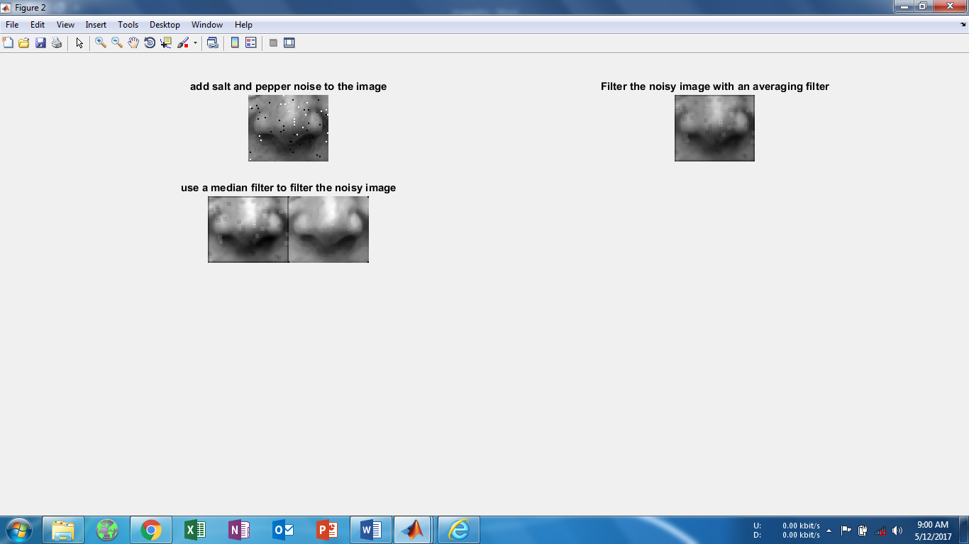
Removal of noise
Read image into the workspace .
I = imread('eight.tif');
For this example, add salt and pepper noise to the image. This type of noise consists of random pixels being set to black or white (the extremes of the data range).
J = imnoise(I,'salt & pepper',0.02);
Filter the noisy image, J, with an averaging filter and display the results. The example uses a 3-by-3 neighborhood.
Kaverage = filter2(fspecial('average',3),J)/255;
Now use a median filter to filter the noisy image, J. The example also uses a 3-by-3 neighborhood.
Kmedian=medfilt2(J);

Slide 14
Edge detection
The Sobel operator, sometimes called the Sobel–Feldman operator or Sobel filter, is used in image processing and computer vision, particularly within edge detection algorithms where it creates an image emphasising edges. Technically, it is a discrete differentiation operator, computing an approximation of the gradient of the image intensity function. At each point in the image, the result of the Sobel–Feldman operator is either the corresponding gradient vector or the norm of this vector. The Sobel–Feldman operator is based on convolving the image with a small, separable, and integer-valued filter in the horizontal and vertical directions and is therefore relatively inexpensive in terms of computations. The operator uses two 3×3 kernels which are convolved with the original image to calculate approximations of the derivatives – one for horizontal changes, and one for vertical.

Slide 15
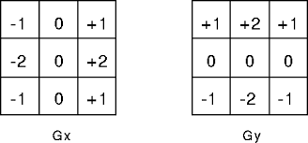
Code:
C=double(Kmedian)
for i=1:size(C,1)-2
for j=1:size(C,2)-2
%Sobel mask for x-direction:
Gx=((2*C(i+2,j+1)+C(i+2,j)+C(i+2,j+2))-(2*C(i,j+1)+C(i,j)+C(i,j+2)));
%Sobel mask for y-direction:
Gy=((2*C(i+1,j+2)+C(i,j+2)+C(i+2,j+2))-(2*C(i+1,j)+C(i,j)+C(i+2,j)));
%The gradient of the image
%B(i,j)=abs(Gx)+abs(Gy);
Kmedian(i,j)=sqrt(Gx.^2+Gy.^2);
end
end

Slide 16
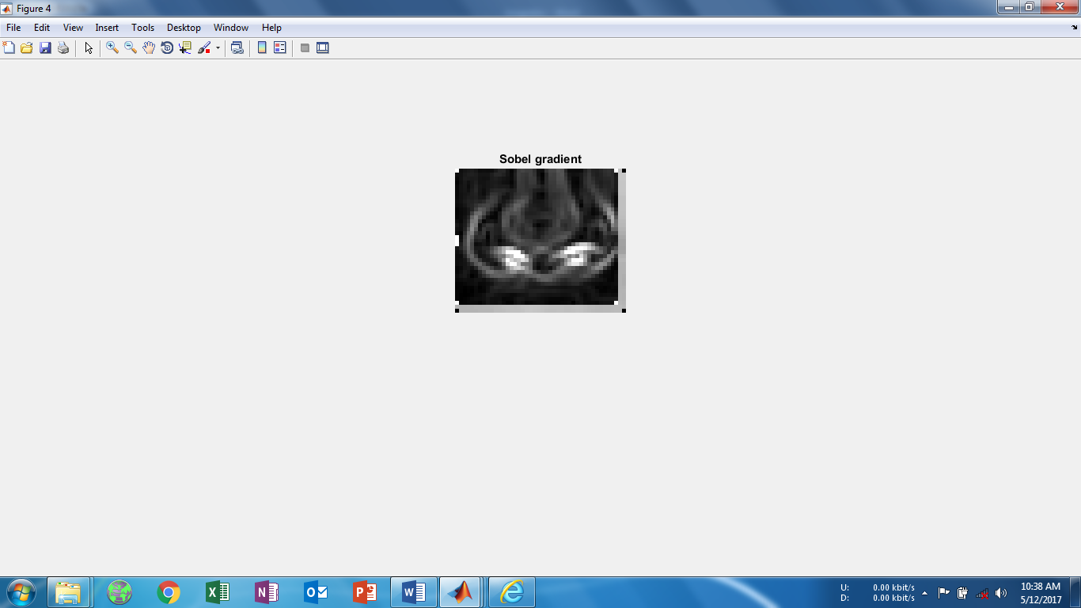
Sobel edge detection used to detect edges of the nose

Slide 17
Finding the nose width and height
[r1,c1] = find(Kmedian);
x2 = max(r1);
x1 = min(r1);
X = x2 - x1
y2 = max(c1);
y1 = min(c1);
Y = y2 - y1
calib=21/2200;
xdist=X*calib;
ydist=Y*calib;
disp(xdist)
disp(ydist)
[i,j] = find(X) returns the row and column indices of the nonzero entries in the matrix X.
Then we find the max row index of the pixel with nonzero value and we find the minimum row index with nonzero value.
Substraction gives us the nose width in pixels.the same also applies for columns with nonzero value.
To convert the pixel distances to inch we have used an appropriate calibration.

Slide 18
Results
Next are some slides which shows our results based on various faces and changing expressions.We have dealt with three popular expressions, Happy,sad and angry and computed the nose width and height along with the nose tip.

Slide 19
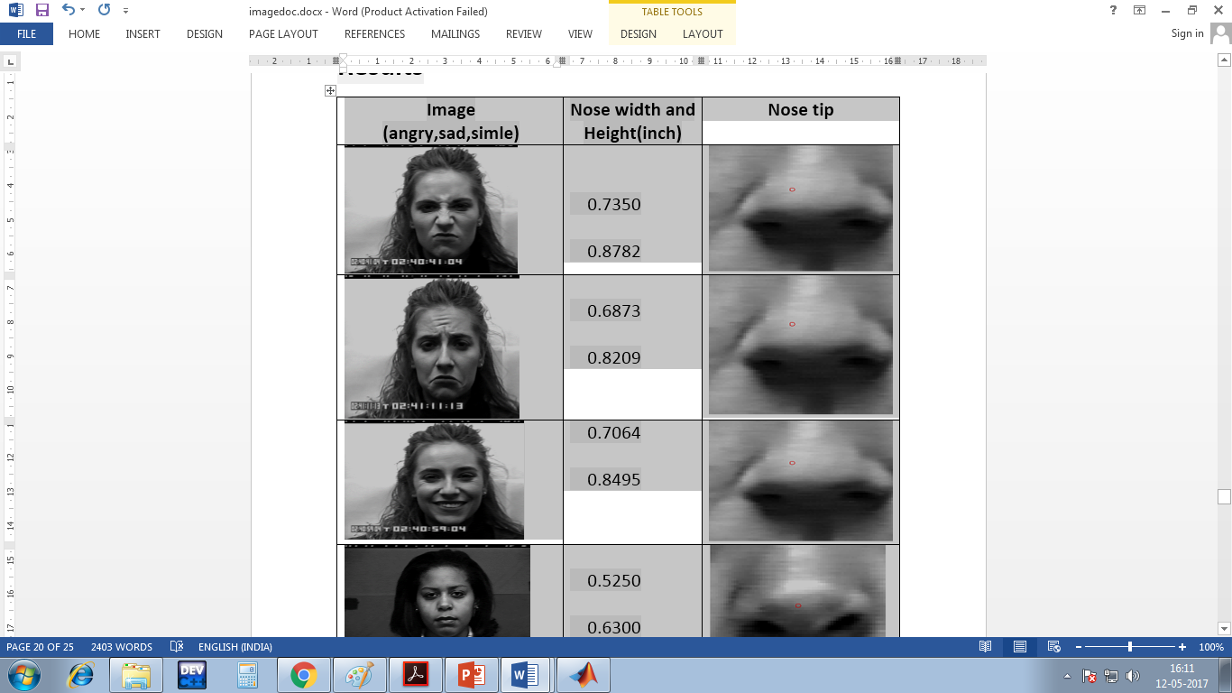

Slide 20
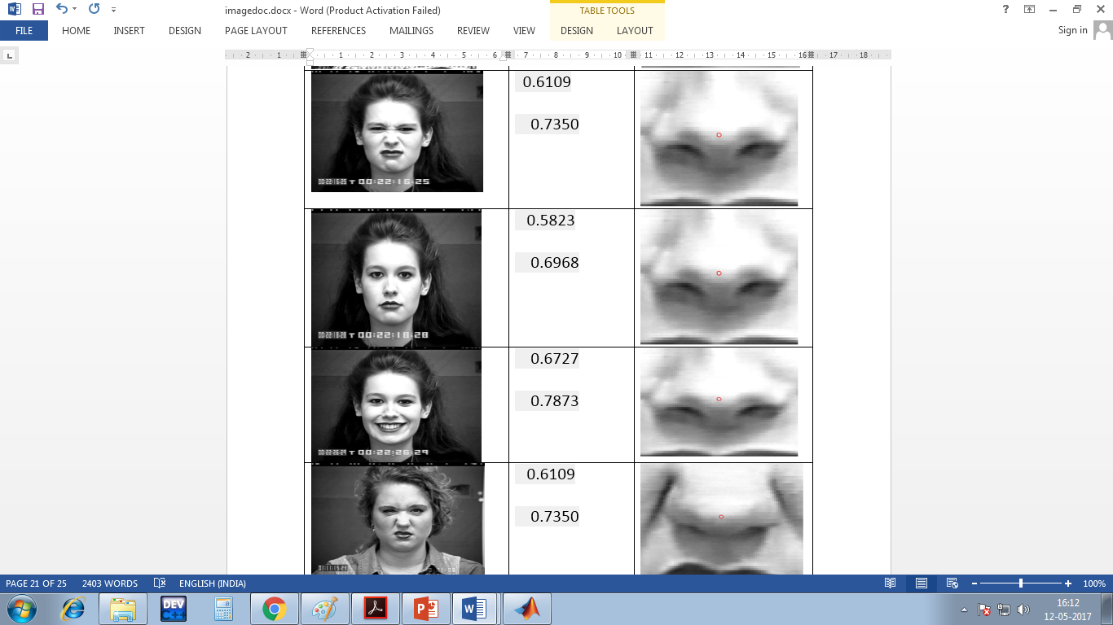

Slide 21
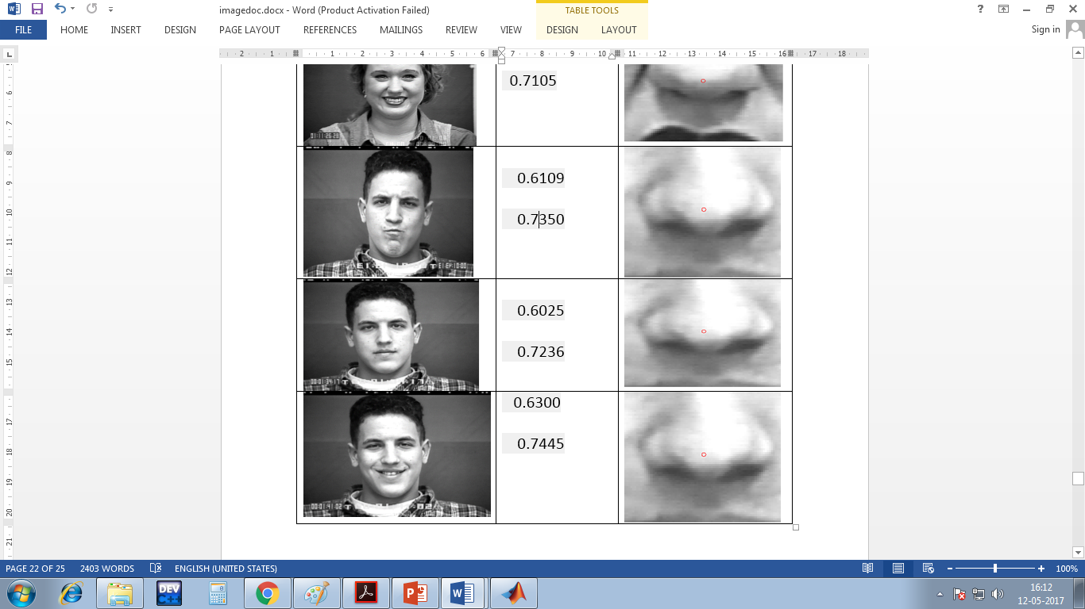

Slide 22
Conclusion
In this experiment, we have detected the nose using Viola-jones algorithm
We have used color based Image Segmentation. We have divided the image into three images based on the intensities of each red, green and blue component within the image. The blue plane is the best choice to use for Image Thresholding because it provides the most contrast between the desired object (foreground) and the background.
We have used Salt and Pepper noise and average and median filtering to remove the noise.
Finally after edge detection using Sobel we have detected the width and the height using find(),max()and min().
Finally, we have applied our code on a set of faces and the corresponding results have been listed in a table. For angry and smiling faces, we have seen that the nose width got enlarged and the nose height changes proportionally.

Slide 23
Thank you

